Slide 1

Spatial Data Basics in ‘R’
Mary Lennon
GIS Specialist & Data Scientist
@MaryELennon

Slide 2
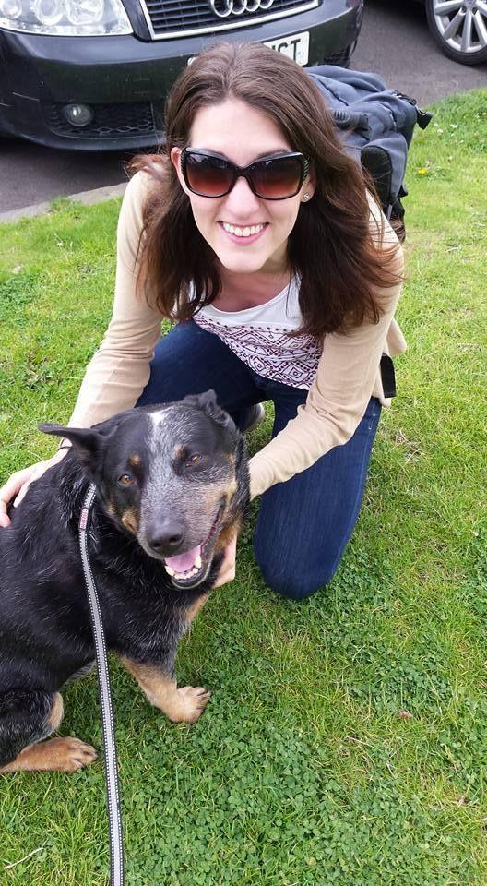
Who am I?
GIS Specialist & Data Scientist at AECOM
Used to be an archaeologist
Work in CRM
Do other types of projects too.
Live in Delaware.
Getting ready to sell my house. Yikes!
Addicted to my Twitter feed
Love my dog Eli!!!
Love learning new things!

Slide 3

Who do I work for?
AECOM
Engineering & more
Global – 150 countries
Approx. 450 offices
87,000 employees
Fortune 500 list
Service Lines ranging from engineering to environmental sciences and archaeology.

Slide 4
What does being a GIS Specialist, at AECOM, look like
day to day ?
@MaryELennon

Slide 5




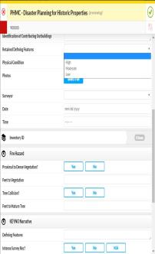






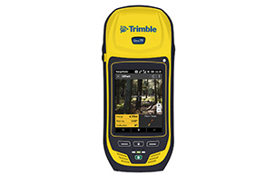
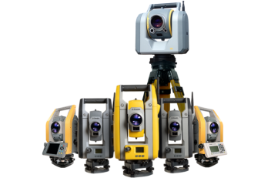




Data Management
Data Platform
RTK Network
Backup
Arrow 200
GPS - RTK
TruPulse
200x
Laser
Rang Finder
Data Management Hub
Tablet & App
@MaryELennon

Slide 6
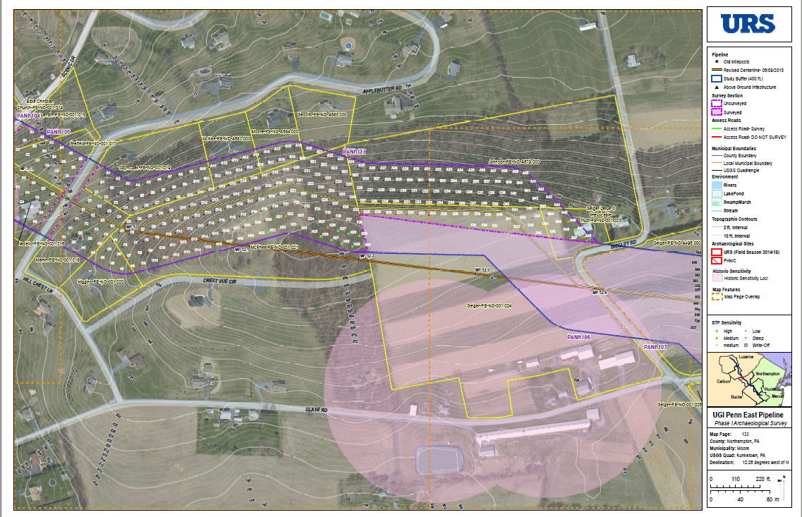
Data Management: Large Engineering Projects
@MaryELennon

Slide 7
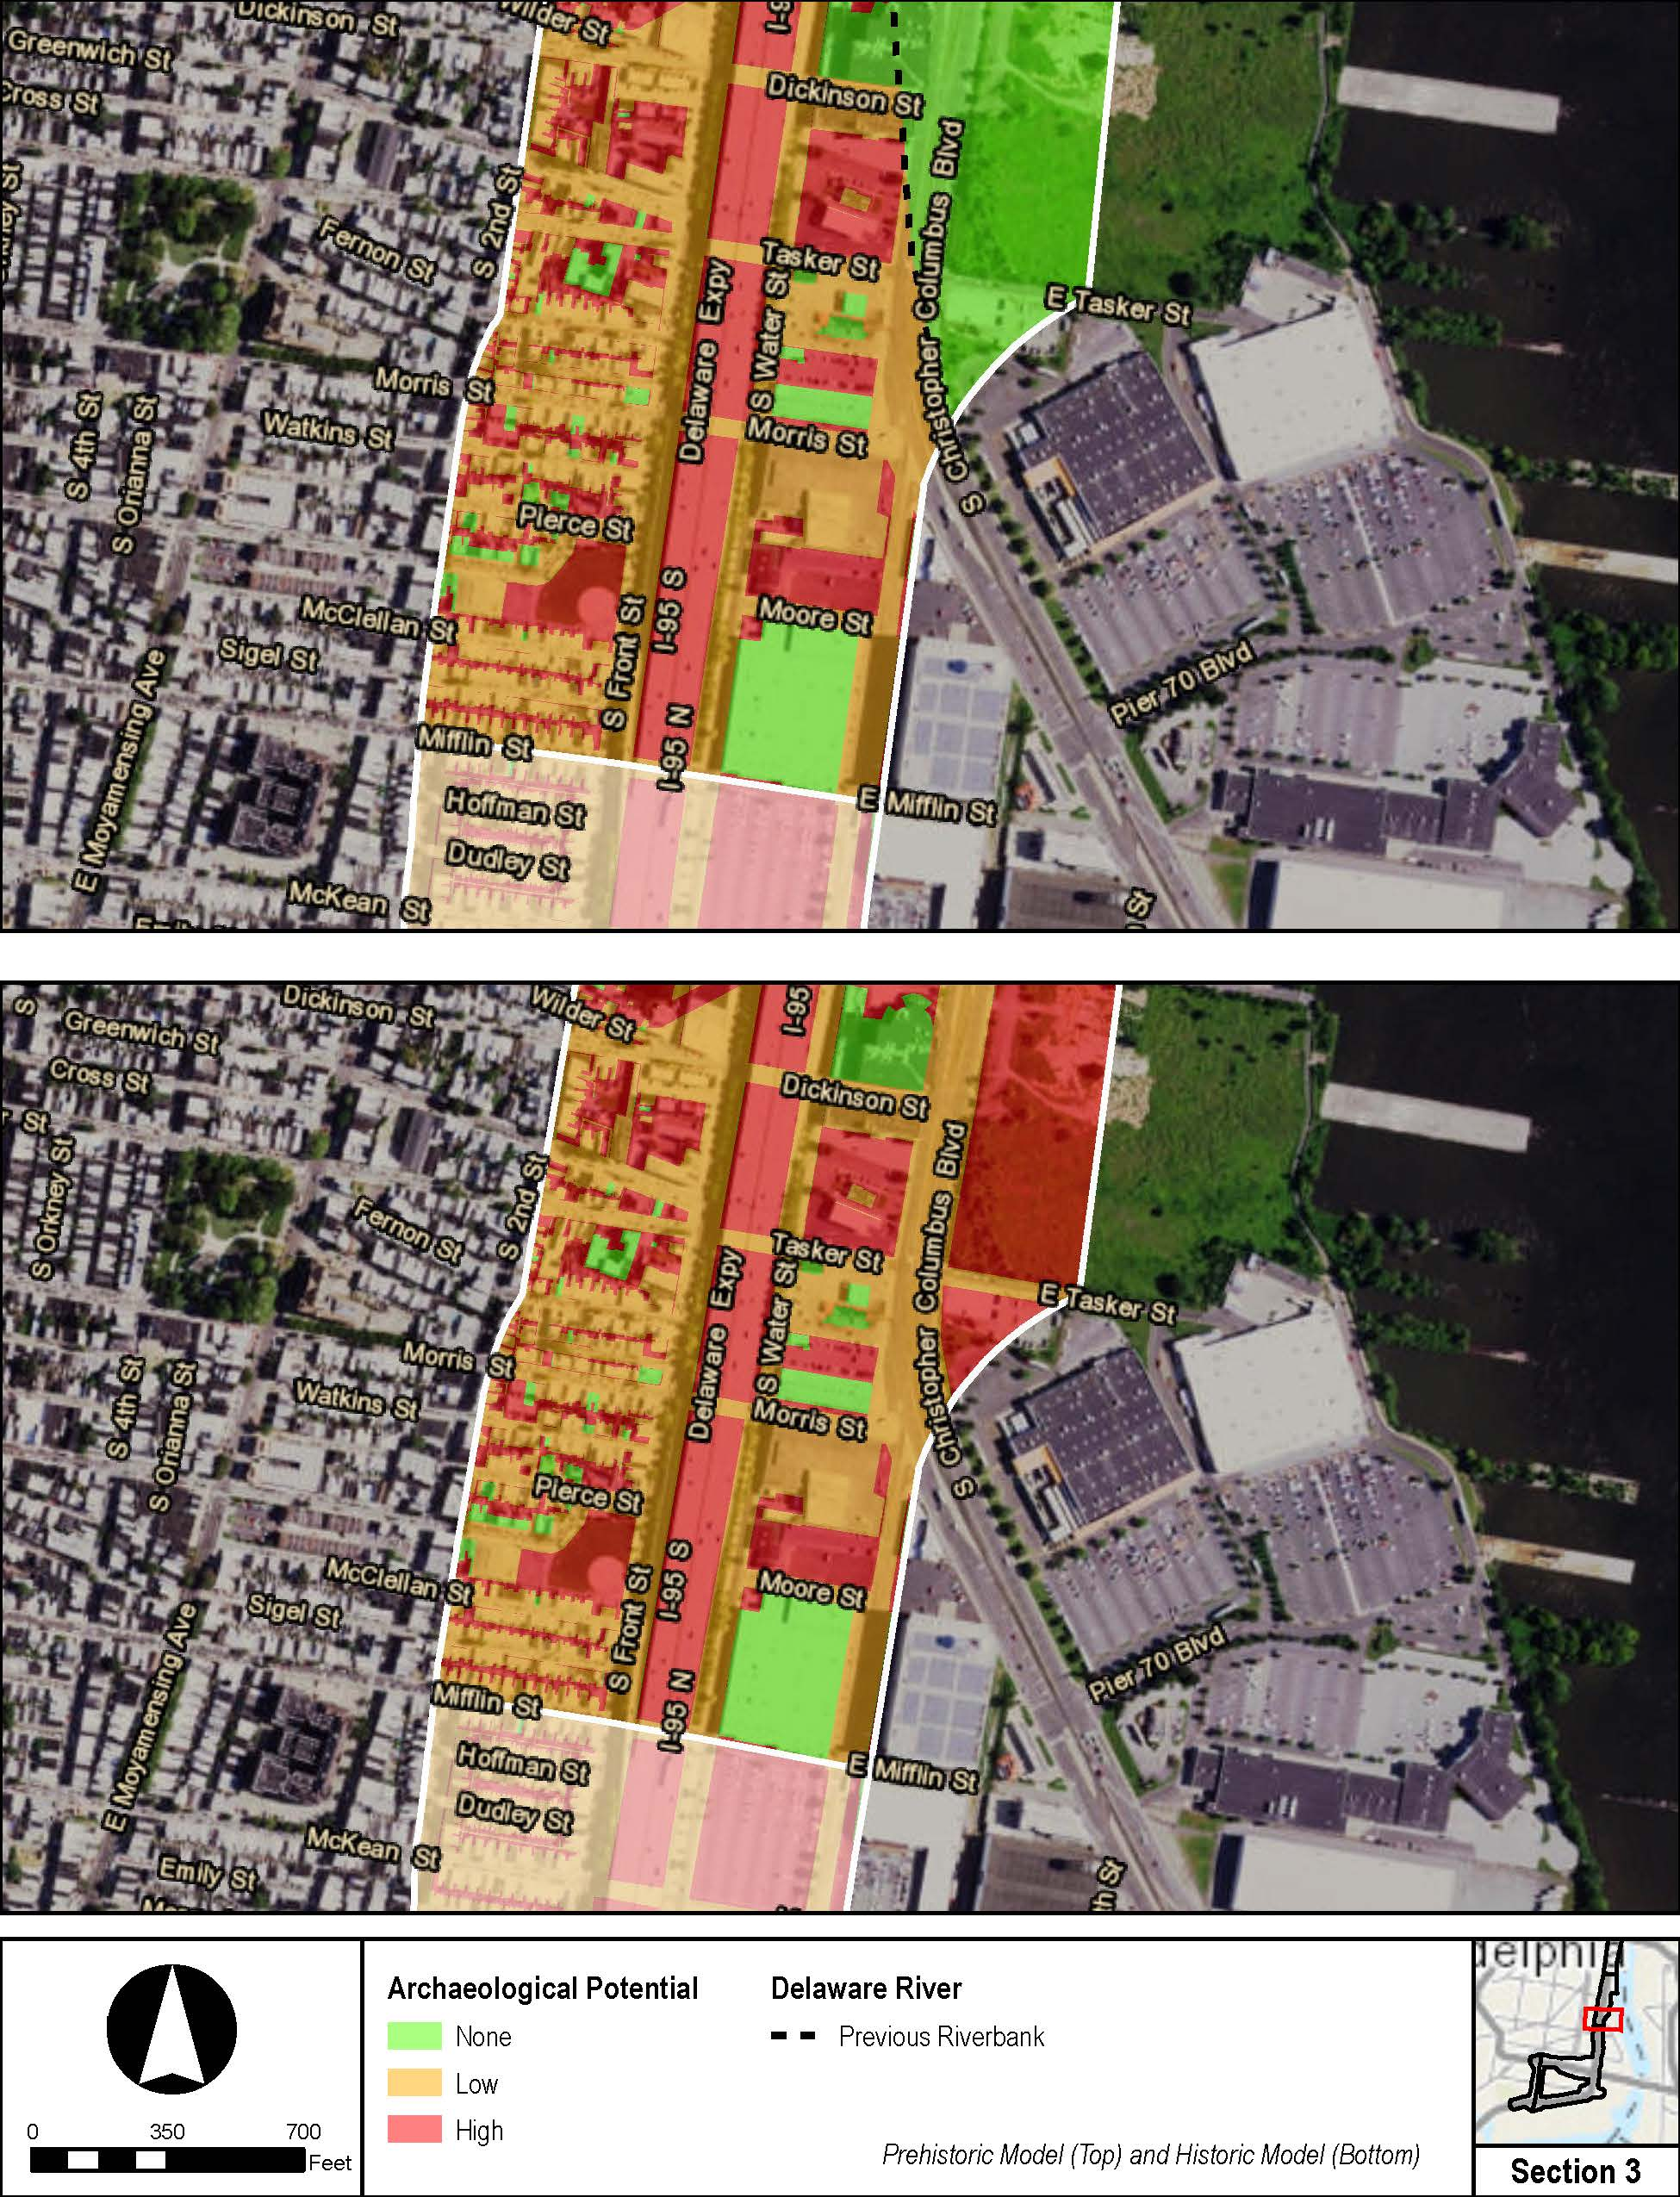
Data Analysis – Archaeological Sensitivity Model
@MaryELennon

Slide 8
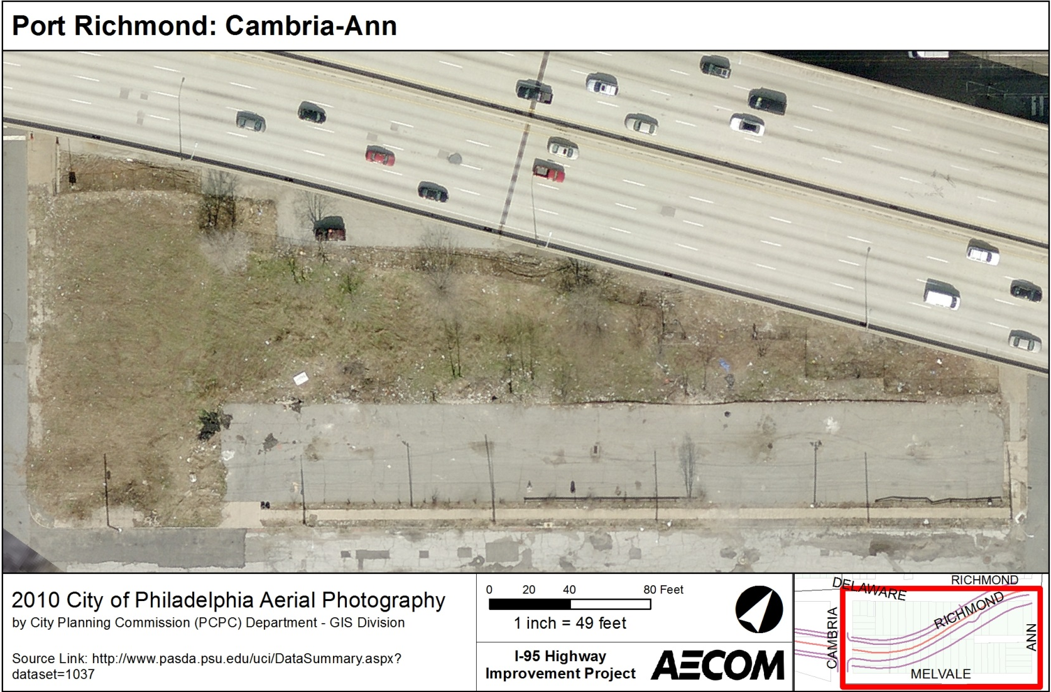
Data Analysis – Geo-referencing
@MaryELennon

Slide 9
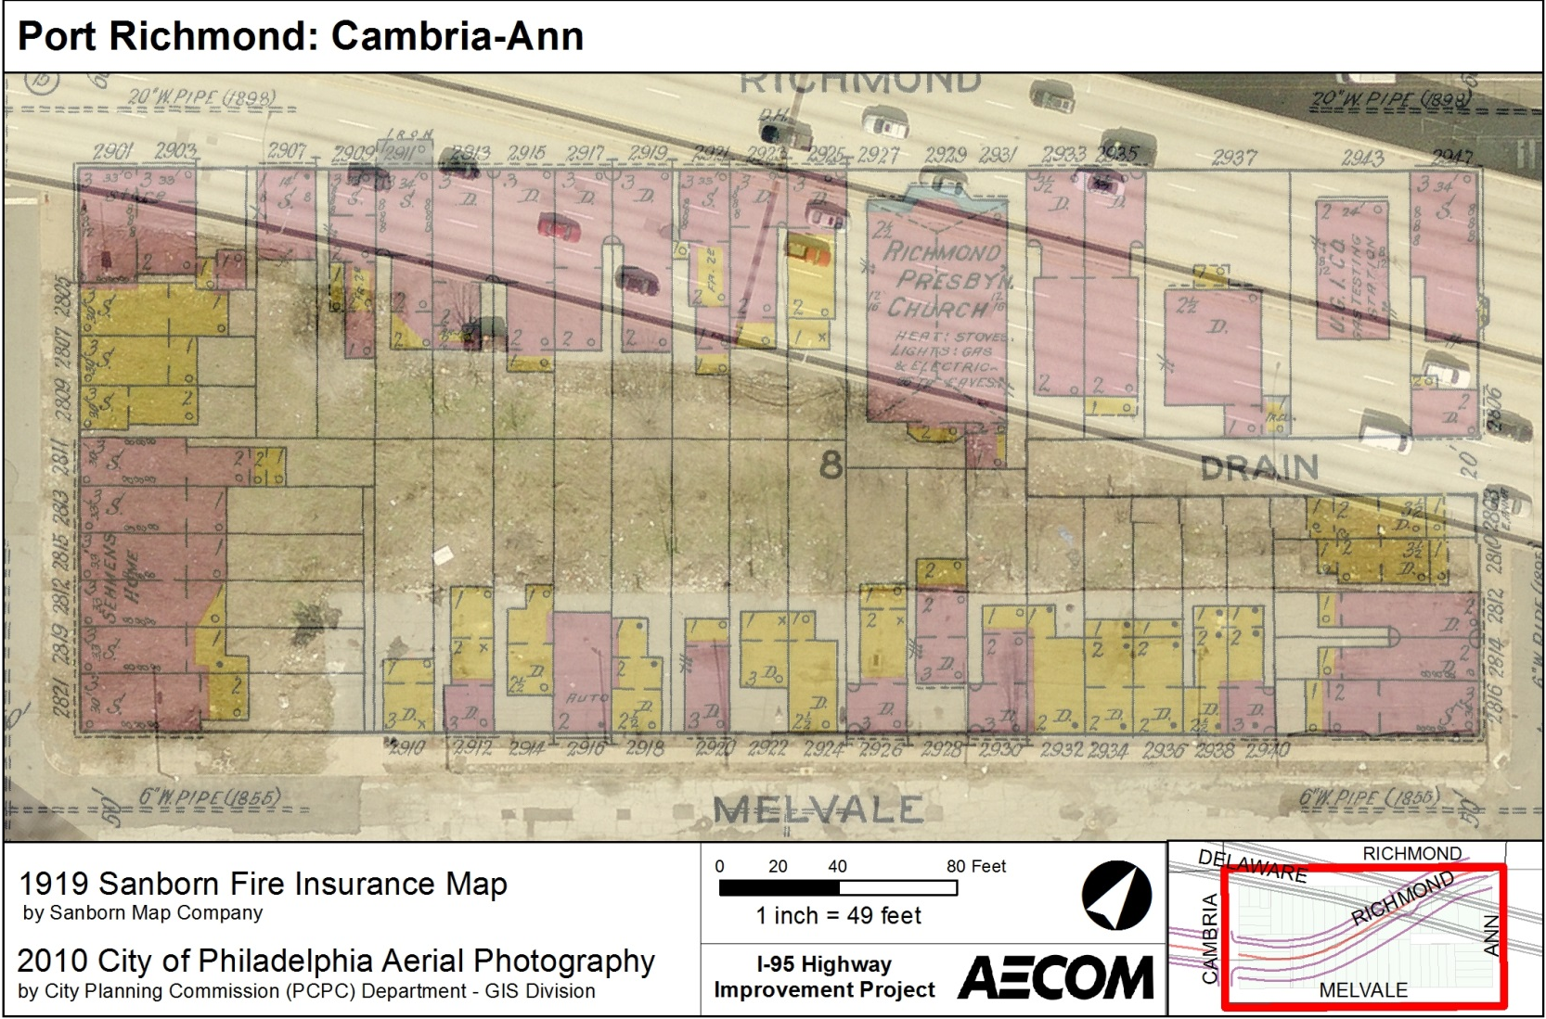
Data Analysis – Geo-referencing
@MaryELennon

Slide 10
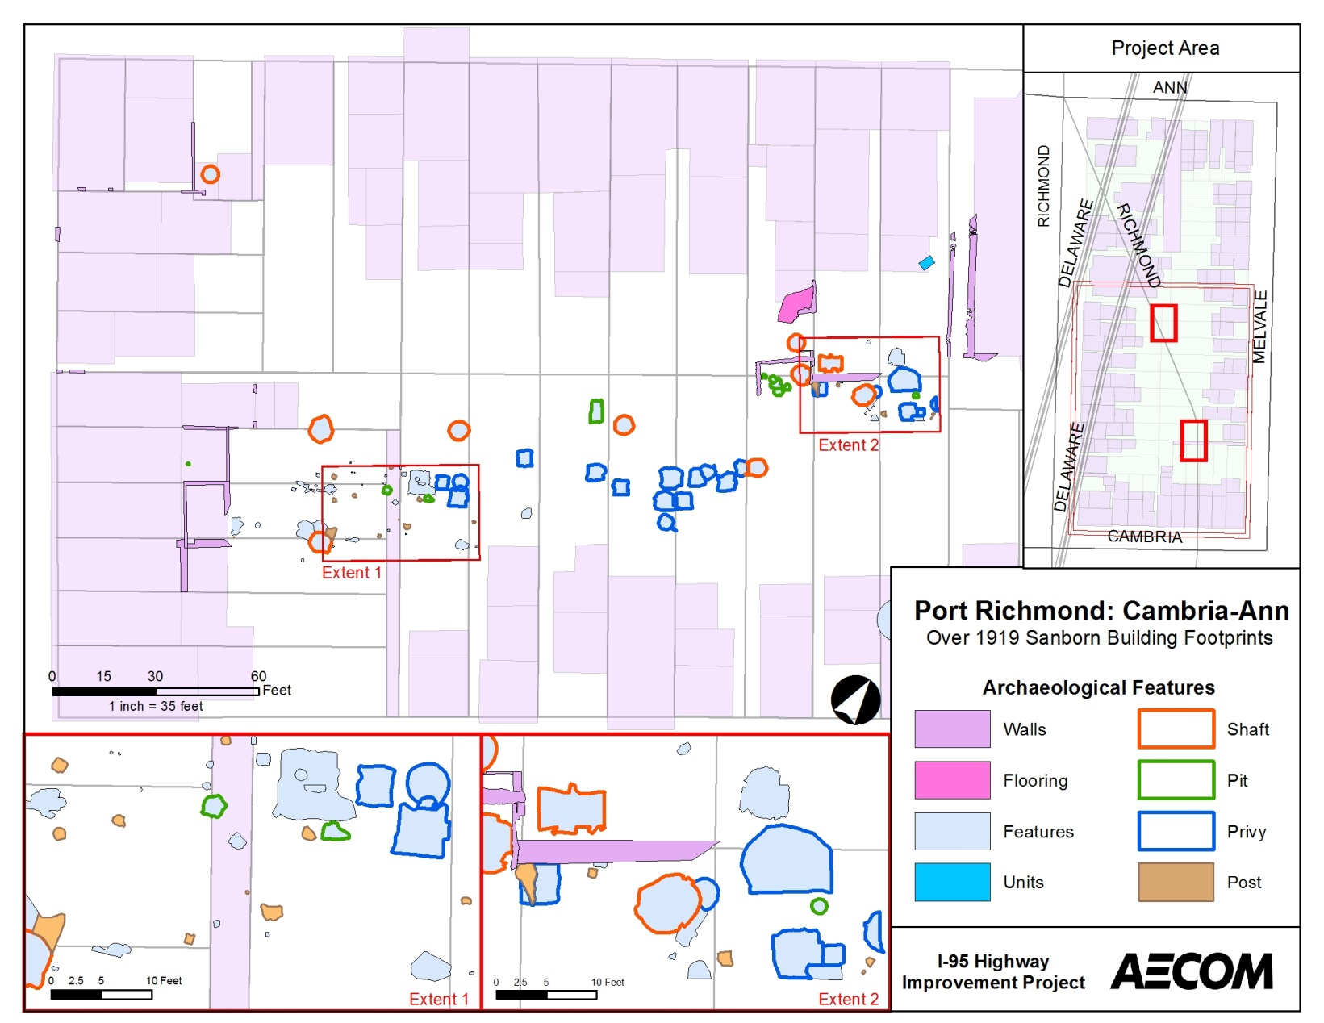
Data Analysis – Feature Locations
@MaryELennon

Slide 11
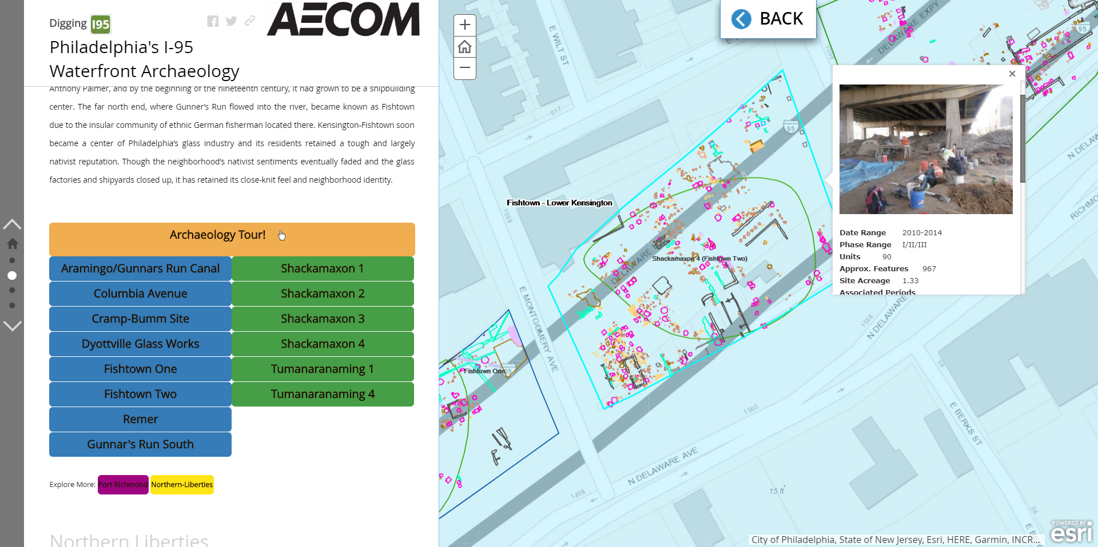
Story Map
http://diggingi95.com/
@MaryELennon

Slide 12
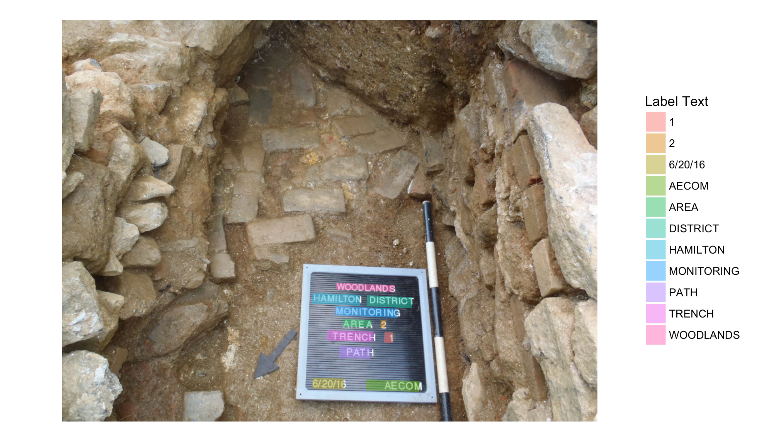
Data Analysis – Text Extraction
@MaryELennon

Slide 13
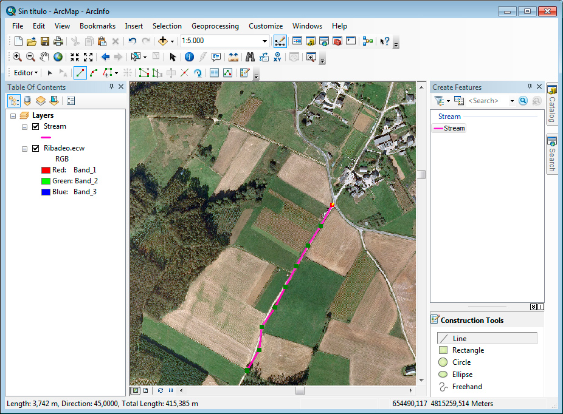
(Muelas, 2018)
@MaryELennon

Slide 14
Let’s dig in!!!!!!!!!
Grab your data and code:
https://github.com/MaryELennon/RLadies_Spatial
@MaryELennon

